Slide 1
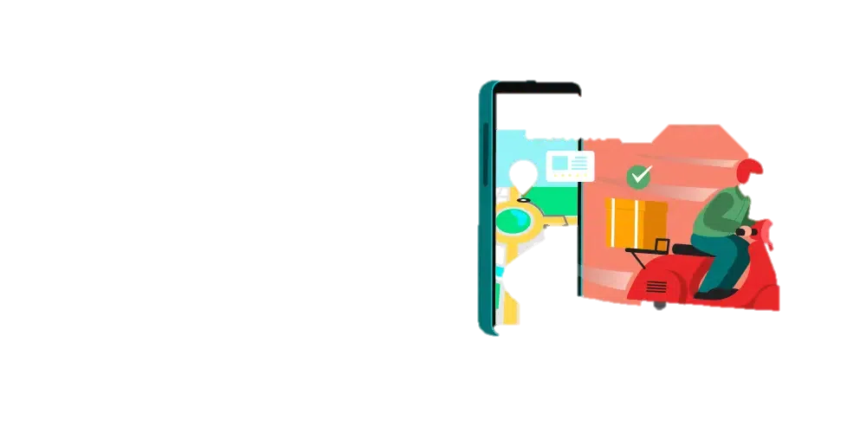
Welcome to My Project Proposal Presentation

Slide 2
Food Delivery Management System
A Full-Stack Web Application Project Proposal

Slide 3
Consultant: Mohammad Moshaidul Islam WDPF Isdb-bisew IT Scholarship Email:moshaidul@gmail.com
Instructor:
Farhana Akter Lucky
WDPF Isdb-bisew IT Scholarship
Email: farhanawdpf@gmail.com
Developed By:
Mohammad Alamgir Rejvi
ID: 1288420
Batch: WDPF/NCLC-M/65/01
Round: 65

Slide 4
Index of The Project Proposal
Index | Slide No.
Application | 5
2. Introduction | 6
3. Objectives | 7
4. Entity Relationship Diagram | 8
5. Flowchart of The Software | 9
6. Modules and Key Features | 10-11
7. Timeline and Milestones | 12
8. Tools and Technologies | 13
9. Form Sample | 14
10. Dashboard Sample | 15
11. Conclusion | 16
12. Thanks | 17

Slide 5
Application
6th January, 2025
The Consultant
IDB Bhaban,
Sher e Bangla, Nagar, Dhaka
Subject : Project proposal letter for the Hostel Management System.
Dear sir,
Thank you for offering us a great opportunity to make a real-life project based on our core course that is Web Development with PHP and Framework(WDPF). In this project, I would like to inform you that I have decided to make a project on Food delivery management system , which is most important for modern-life. I have studied about the various aspects of the system and make a proposal accordingly which is enclosed here with for your kind perusal.
So, I think you will finally Approved the project and help to utilize our creativity.
Sincerely,
Name: Mohammad Alamgir Rejvi
Batch: WDPF/NCLC-M/65/01
Round - 65

Slide 6
Introduction
In the age of digital transformation, the demand for online food ordering and delivery services has grown rapidly. To meet this demand efficiently, we present the Food Delivery Management System—a comprehensive web-based platform designed to streamline the interaction between customers, restaurants, and delivery personnel.
This project focuses on automating the entire food delivery cycle—from menu browsing and order placement to payment processing and delivery tracking. It eliminates manual processes and enhances user experience by ensuring real-time communication, secure transactions, and operational transparency.
By integrating modern technologies, the system provides administrators with control over user management, restaurant listings, category handling, delivery tracking, and system configurations—creating a robust and scalable solution suitable for real-world deployment.

Slide 7
Key Objectives
Automate the food ordering and delivery process from start to finish.
Simplify user experience for browsing menus, placing orders, and making payments.
Enable restaurant owners to manage menus, categories, orders, and customer feedback.
Track delivery agents and their delivery statuses in real time.
Provide an admin panel for managing users, restaurants, categories, orders, and system settings.
Support secure authentication and authorization for customers, admins, and delivery personnel.
Generate reports for order tracking, revenue, and system activity.
Ensure scalability and performance, capable of handling many users and transactions simultaneously.

Slide 8
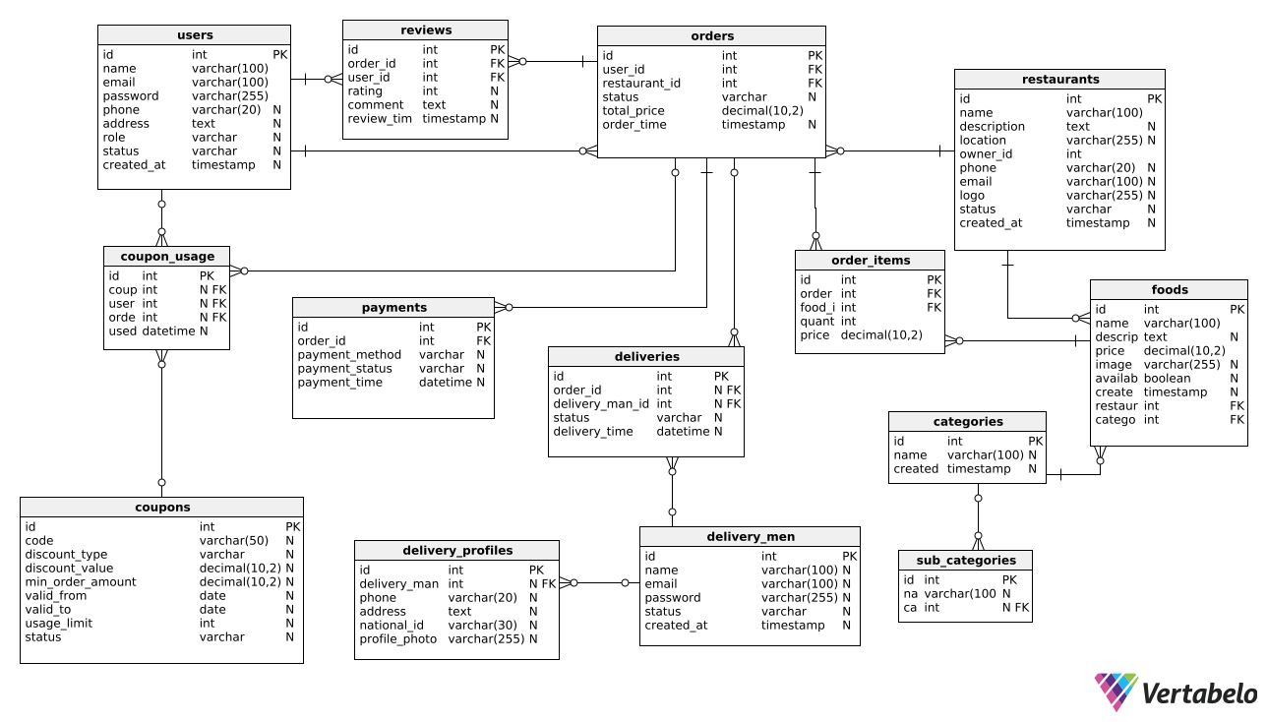
Entity Relationship Diagram

Slide 9
Flowchart of Software
Start
Customer SignUp
LogIn
Pick Up and Delivery
Assign to delivery
Set location and select Restaurant
Order receive and Preparing Food by Restaurant
Received by Customer
Food selection and add checkout
End
Cash on delivery
Order confirm and payment
Online Payment

Slide 10
Modules and features
👨‍💼 Admin Module
Key Features:
Admin authentication & secure login
Dashboard with system overview
User management (CRUD)
Restaurant and food category management
Payment & delivery fee settings
Order and delivery tracking
Reporting & analytics
Coupon and discount management
System configuration
👤 User Module
Key Features:
User registration & login
Profile editing & password management
Browse restaurants & food items
Add to cart and place orders
Choose delivery address
Track order status
Payment (COD / Online)
Rate and review restaurants/foods

Slide 11
Modules and features
🍴 Restaurant Module
Key Features:
Restaurant registration/login
Manage restaurant profile & menus
Add/edit/delete food items
View and update order status
Monitor sales and earnings
Set food availability
🚴 Delivery Module
Key Features:
Delivery man management (add/edit)
Delivery profile with NID, phone, address
View assigned deliveries
Update delivery status (in progress, delivered)
Track delivery time and performance
Delivery reporting

Slide 12
Timeline and Milestone
Milestone | Days
Planning & Analysis | 5
Backend & Admin Panel Development | 11
Restaurant & Delivery Modules | 6
User Module Development | 6
Testing & Deployment | 3
Total days | 30

Slide 13
Tools and Technologies:
Tools and Technology | Description | Tools and Technology | Description
PHP | Server-side scripting language used for dynamic web development | jQuery | JavaScript library for simplifying HTML document traversal and manipulation
MySQL | Relational database management system for storing and retrieving data | Git | Version control system for tracking and managing code changes
HTML | Markup language for creating the structure and content of web pages | PhpStorm | Integrated development environment (IDE) for PHP development
CSS | Styling language for enhancing the appearance and layout of web pages | phpMyAdmin | Web-based administration tool for managing MySQL databases
JavaScript | Client-side scripting language for interactive and dynamic web functionality | Tailwind and Bootstrap | CSS framework for creating responsive and mobile-friendly web designs

Slide 14
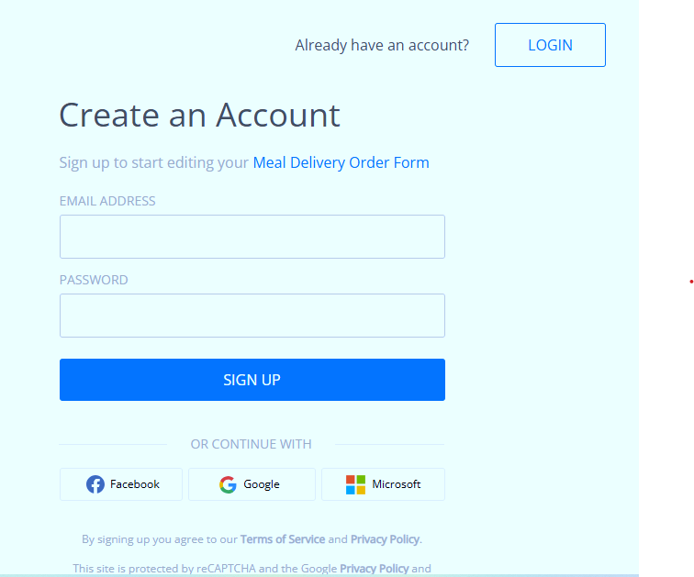
Form Sample

Slide 15
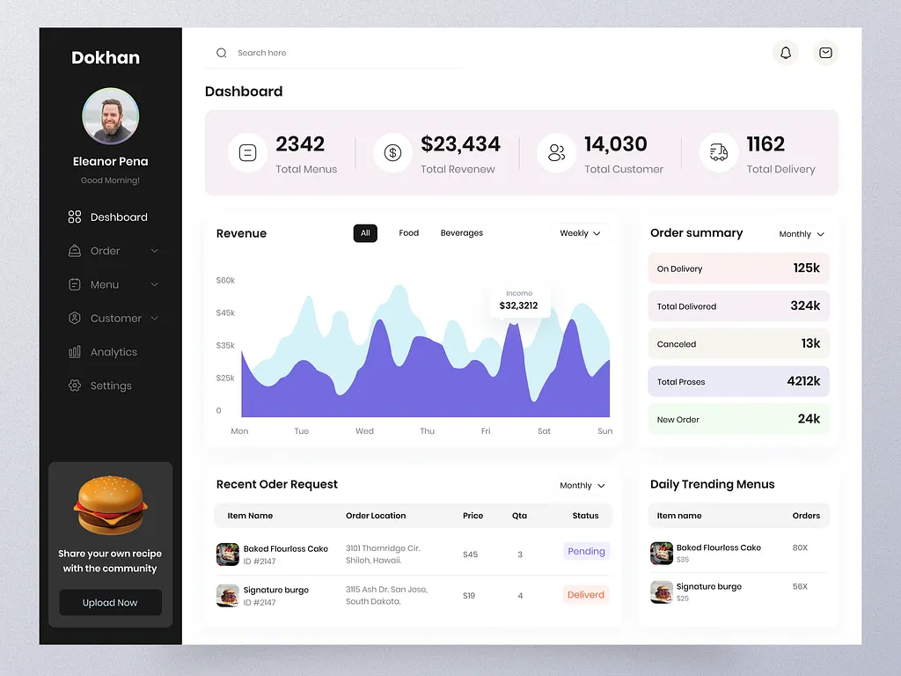
Dashboard

Slide 16
Conclusion
The Food Delivery Management System is a complete digital solution designed to streamline the entire food delivery process—from order placement to final delivery. By integrating features for administrators, customers, restaurants, and delivery personnel, the system enhances operational efficiency, reduces manual workload, and ensures a seamless user experience.
Through this project, we have implemented a modular, scalable, and user-friendly platform that reflects real-world food delivery operations. It not only improves communication between different stakeholders but also supports data-driven decision-making with real-time tracking and reporting features.
This system demonstrates the power of modern web technologies in solving practical problems, and it lays the foundation for future enhancements like mobile app integration, real-time notifications, and AI-based recommendations. Ultimately, the project aims to improve service quality and customer satisfaction in the growing food delivery industry.

Slide 17
Thanks For Watching

